Slide 1

MSCS Literacy Commitment
School Name: Hickory Ridge Elementary

Slide 2

Agenda
TN Learning Loss Remediation and Student Acceleration Act
Pathways to Fourth Grade
Additional Opportunities
Notifications

Slide 3

TN Learning Loss Remediation and Student Acceleration Act
What does the TN law say about 3rd graders?
Focus: “Accelerating Student Learning”
“Beginning with the 2022-2023 school year, a student in the third grade shall not be promoted to the next grade level unless the student is determined to be proficient in English Language Arts (ELA) based on the student's achieving a performance level rating of ”meets" or ”exceeds" on the ELA portion of the student's most recent Tennessee comprehensive assessment program (TCAP) test.”

Slide 4

Pathways to 4th Grade for Approaching and Below Proficient Scores

Slide 5

Approaching
What does the law say about students who score “approaching” on the TCAP assessment?

Slide 6

Tennessee Learning Loss Remediation and Student Acceleration Act
A student in grade three (3) who is not proficient in ELA, as determined by the student's achieving a performance level rating of “approaching” on the ELA portion of the student's most recent TCAP test, may be promoted to the fourth (4th) grade if:
The student attends a learning loss bridge camp before the beginning of the upcoming school year, Maintains a ninety percent (90%) attendance rate at the camp, AND the student's performance on the post-test administered to the student at the end of the learning loss bridge camp, demonstrates adequate growth (5 percentage points), as defined in the State Board’s Promotion and Retention Policy 3.300; OR The student receives high-dosage, low-ratio tutoring for the entirety of the upcoming school year from a Tennessee accelerating literacy and learning corps (TALLC) tutor. For the purposes of this rule, “high-dosage, low-ratio tutoring” means a minimum of two (2) thirty (30) minute sessions per week with a one to three (1:3) teacher to student ratio. TALLC high dosage, low ratio tutoring may be provided through the following options, (I) A tutor recruited and trained through the Department’s TN ALL Corps program. (II)A district recruited tutor who has completed the Department’s TN ALL Corps training.

Slide 7
Below Proficient
What does the law say about students who score “below proficient” on the TCAP assessment?

Slide 8

Tennessee Learning Loss Remediation and Student Acceleration Act
A student in grade three (3) who is not proficient in ELA, as determined by the student's achieving a performance level rating of “below” on the ELA portion of the student's most recent TCAP test may be promoted to the fourth (4th) grade if:
The student attends a learning loss bridge camp before the beginning of the upcoming school year AND Maintains a ninety percent (90%) attendance rate at the camp, AND Receives high-dosage, low-ratio tutoring for the entirety of the upcoming school year from a Tennessee accelerating literacy and learning corps (TALLC) tutor. For the purposes of this rule, “high-dosage, low-ratio tutoring” means a minimum of two (2) thirty (30) minute sessions per week with a one to three (1:3) teacher to student ratio. TALLC high dosage, low ratio tutoring may be provided through the following options, (I) A tutor recruited and trained through the Department’s TN ALL Corps program. (II) A district recruited tutor who has completed the Department’s TN ALL Corps training.

Slide 9
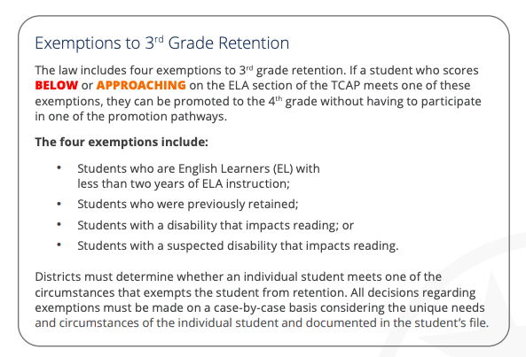
Tennessee Learning Loss Remediation and Student Acceleration Act
Exemptions to 3rd Grade Retention
Any 3rd grade student can be exempt if they fall within any of these categories.

Slide 10

Additional Opportunities

Slide 11
Retake/Retest Opportunities
If a student scores approaching OR below proficient, he/she will be given the opportunity to retake the ELA portion of the TCAP assessment, which excludes the writing.
This retake will be administered on the computer.
The retake dates have not been released as of yet from the state department.

Slide 12

Notifications

Slide 13
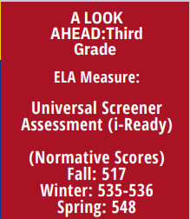
Parent Notification
By February 1 of each year, parents must be informed if their child is “at risk” of being retained. It is required by the state and letters must be sent home. Your child's teacher will contact you after the winter i-Ready assessment if your child has been identified as "at risk".
“At risk” students are identified if they score below the 65th percentile on the ELA winter universal screener.

Slide 14
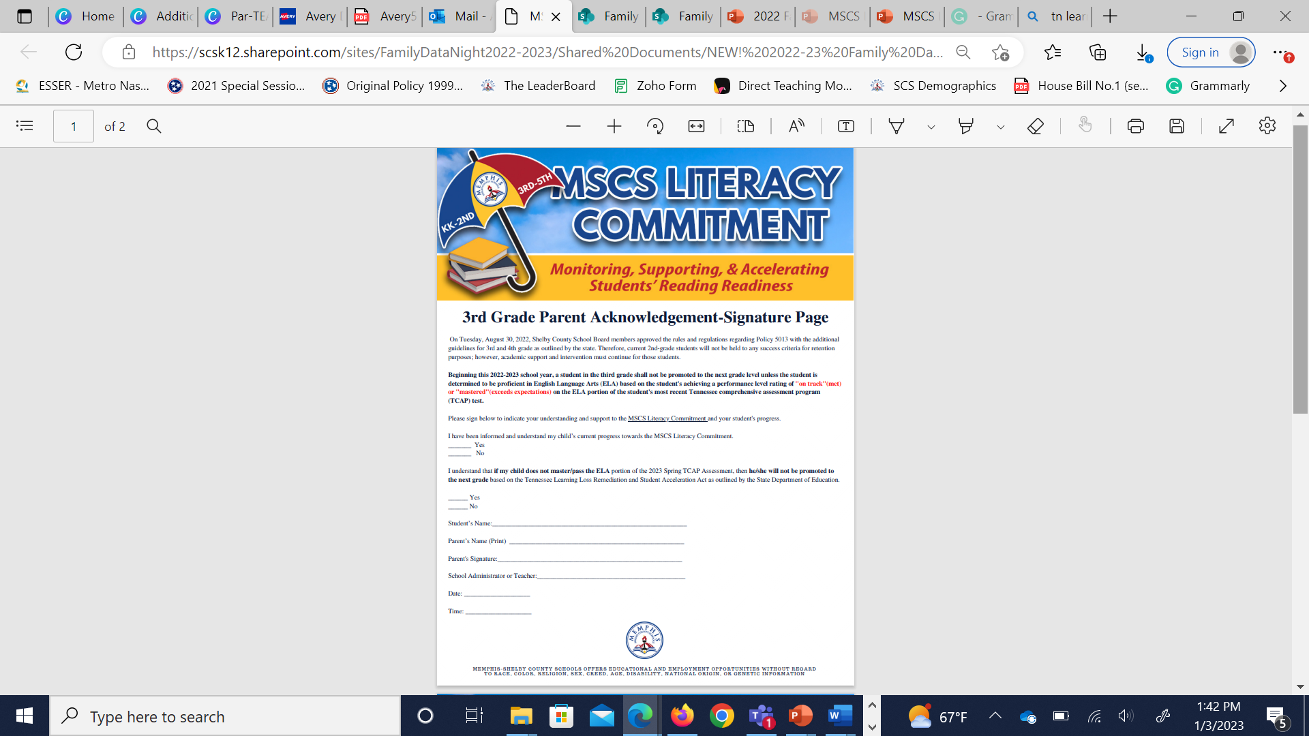
Electronic Parent Acknowledgement-Signature Page in PowerSchool
The purpose of the Parent Acknowledgment- Signature Page is to:
Indicate your understanding and support to the MSCS Literacy Commitment and your student's progress.
Acknowledge that you have been informed and understand your child’s current progress towards the MSCS Literacy Commitment.
Acknowledge that you understand that if your child does not master/pass the ELA portion of the 2025 Spring TCAP Assessment, then he/she will not be promoted to the next grade based on the Tennessee Learning Loss Remediation and Student Acceleration Act as outlined by the State Department of Education.

Slide 15


